Slide 1
CSSE 332 Filesystem(I)
Monday, December 16, 2019
Adapted from ND CSE 30341 Operating System Principles (Fall 2017)

Slide 2
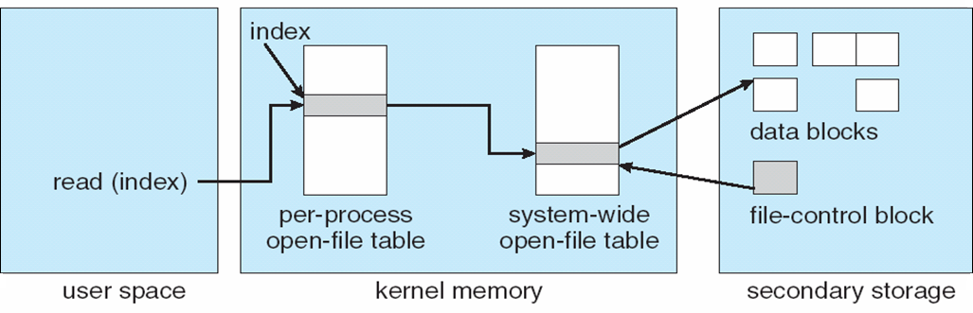
File Table
Given a file name, OS can help us operate on a file.
Via file table
How are files organized on the storage is the job of Filesystem.

Slide 3
3 Main Methods of File Access
I'd like you to evaluate their pros/cons
Some things to consider
Ease of creating new files when space is available
Limits on file size?
Speed of getting data from a specific spot in a file (a.k.a. random access)
Amount of waste in storing metadata

Slide 4
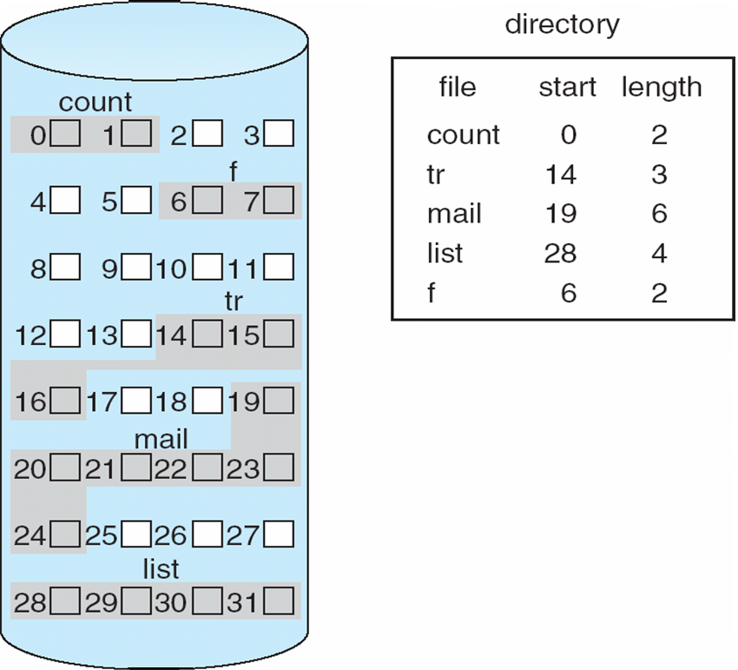
Ways to store files: Contiguous Allocation
Divide disk into fixed-sized blocks (usually 4KB)
One way to organize data region is by using contiguous blocks:

Slide 5
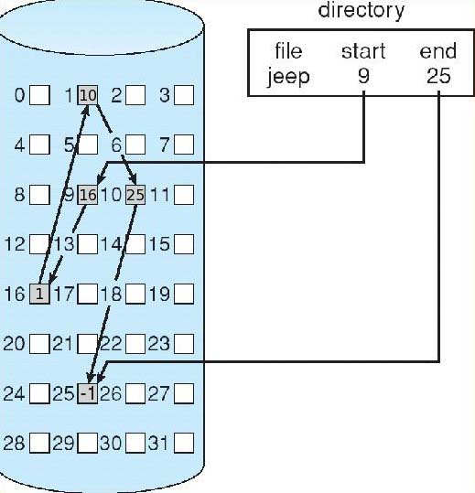
Ways to store files: Linked Allocation
Another way is to use a linked list.
Each block points to next block

Slide 6
Ways to store files: Indexed Allocation
Another way is to use pointers to fixed size blocks
Easy allocation
Good random access
Overhead of pointers
Limited File Size
Data
Inode
Direct 0
Data
Direct 1
Direct 2
Direct 3

Slide 7
Ways to store files: Contiguous Allocation
Divide disk into fixed-sized blocks (usually 4KB)
One way to organize data region is by using contiguous blocks:
Extents describe start and length
Easy and fast to access and lookup data
Difficult to allocate space
Fragmentation

Slide 8
Ways to store files: Linked Allocation
Another way is to use a linked list.
Each block points to next block
Easy allocation
Poor random access
Can use file allocation table to store links
FAT

Slide 9
FAT
Disk is divided into clusters.
A File Allocation Table (FAT) is created on this disk, to map the next cluster (in a file) of a given cluster, like a linked list.
Each cluster in the disk has an entry in FAT.
For a existing file, we only need to indicate the starting cluster of the file.

Slide 10
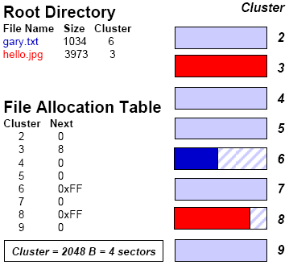
FAT example
In FAT:
0 indicates unallocated
0xFF indicates the end of file.

Slide 11
Pros and Cons of FAT
Advantages:
Simple to use
Cross-platform compatible
Disadvantages:
No random access
Upper-capped file size: 4GB (because it uses 32-bit to denote file size)
Security

Slide 12
Ways to store files: Indexed Allocation
Another way is to use pointers to fixed size blocks
Easy allocation
Good random access
Overhead of pointers
Can have multiple levels of pointers
Data
Inode
Direct 0
Data
Direct 1
Direct 2
Direct 3
Indirect
Data
Unix way
Direct 0
Direct 1
Data

Slide 13
Example: Read a file
open a file (e.g., /foo/bar), read it. For this simple example, let’s assume the file is just 12KB in size (i.e., 3 blocks).
Disk location
 | root inode | foo Inode | bar inode | root data | foo data | bar data[0] | bar data[1] | bar data[2]
open(bar) | read
 |  |  |  | read
 |  | read
 |  |  |  |  | read
 |  |  | read
read() |  |  | read
 |  |  |  |  |  | read
 |  |  |  |  |  |  | read
 |  |  |  |  |  |  |  | read
Time

Slide 14
File System: Organization
Superblock: Keeps track of file system information such as number of blocks and inodes
Inodes: Keeps meta-data about individual files and directories
S
ib
db
Inodes
Data
Inode Bitmap: Keeps track of status of inode
Data Bitmap: Keeps track of status of data block
Data: Holds data corresponding to files and directories

Slide 15
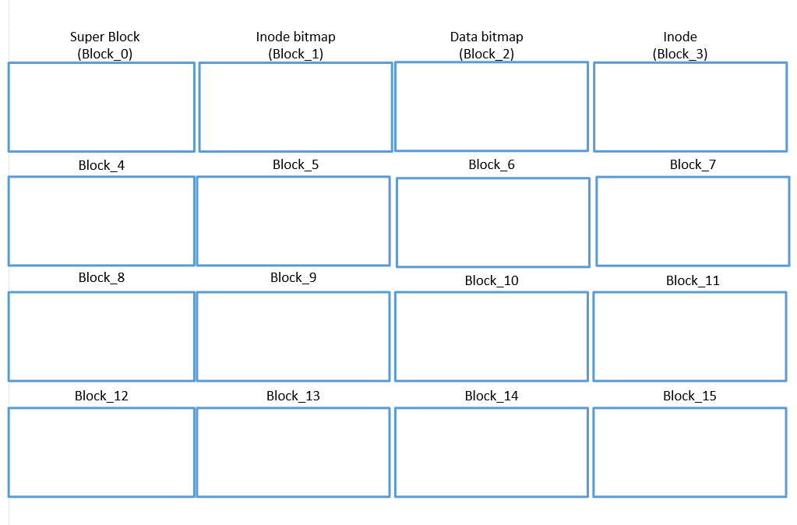
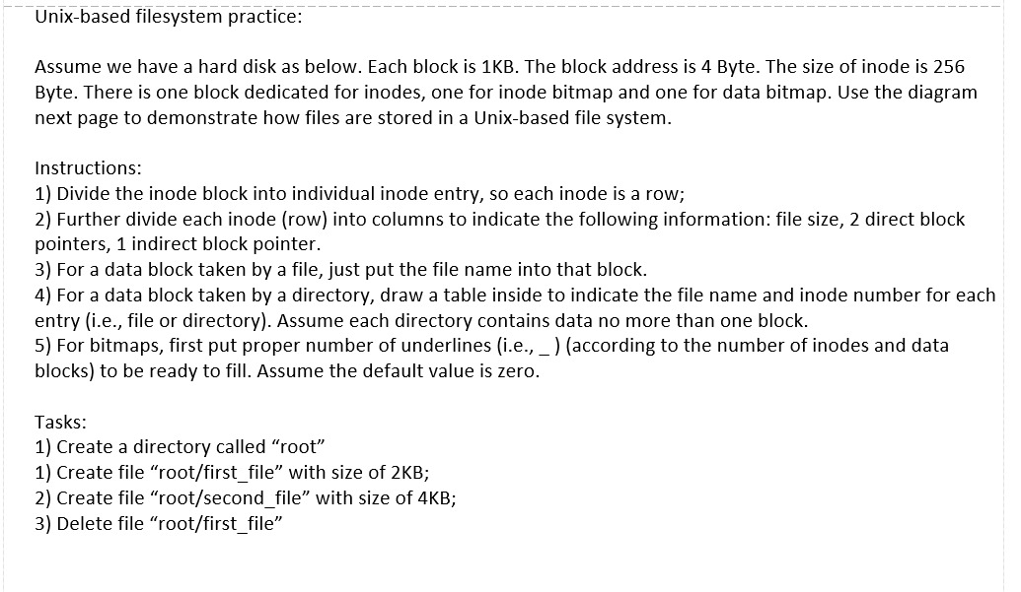
Filesystem practice
Check the handout for activity.

